Slide 1
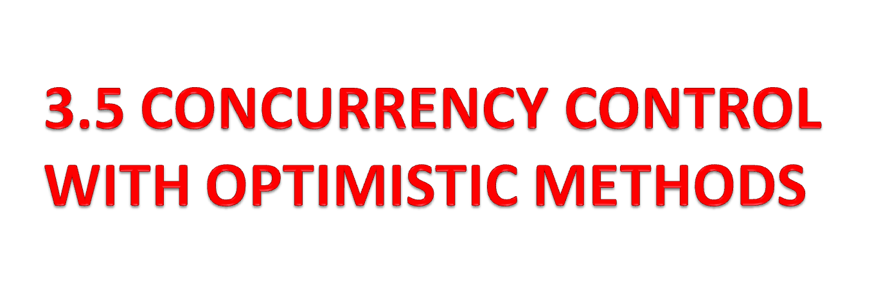

Slide 2
It does not require locking or time stamping techniques.
Instead, a transaction is executed without restrictions until it is committed.
Using an optimistic approach, each transaction moves through two or three phases.
The phases are Read, validation and Write.

Slide 3
During the Read phase,
  the transaction reads the database,
  executes the needed computations
  and makes the updates to a private copy of the database values.
All update operations of the transaction are recorded in a temporary update file, which is not accessed by the remaining transactions.

Slide 4
During the validation phase,
  the transaction is validated to ensure that the changes made will not affect the integrity and consistency of the database.
If the validation test is positive, the transaction goes to the Write phase.
If the validation test is negative, the transaction is restarted and the changes are discarded.

Slide 5
During the Write phase,
  the changes are permanently applied to the database.
The optimistic approach is acceptable for most read or query database systems that require few update transactions.

Slide 6
In a heavily used DBMS environment, the management of deadlocks their prevention and detection constitutes an important DBMS function.
It may be necessary to employ database recovery techniques to restore the database to a consistent state

